Slide 1
Primitive Roots and DiscretE Logarithms

Slide 2
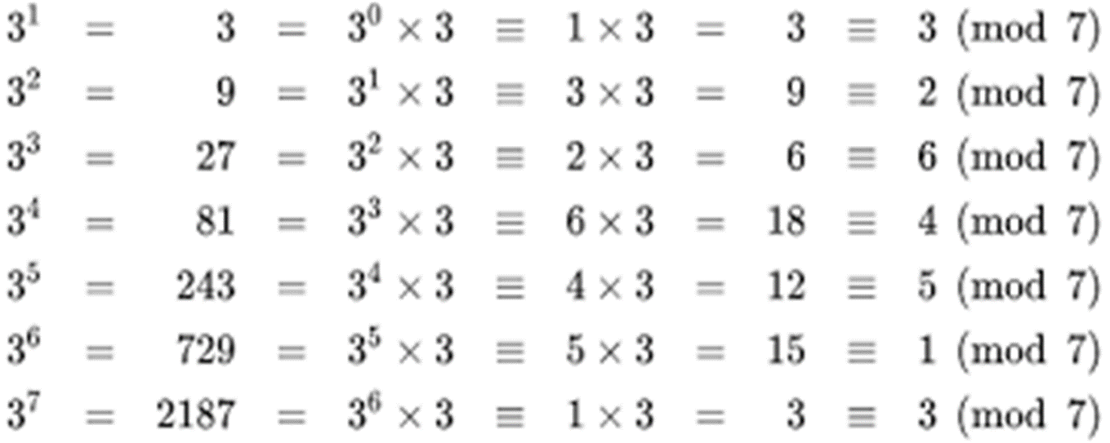
Primitive roots
A primitive root modulo n is an integer g such that every number coprime to n is congruent to a power of g modulo n.
Example:
For n=7, 3 is a primitive root because 3¹,3²,...,3⁶mod 7 generate all numbers from 1 to 6.
The period of 3^{k} modulo 7 is 6
If g is a primitive root modulo n and n is prime, then the period of repetition is n − 1

Slide 3

Primitive roots
Use of primitive roots in cryptography:
Diffie-Hellman Key Exchange
ElGamal Encryption

Slide 4
Discrete logarithm
A discrete logarithm is the inverse operation to exponentiation in the context of modular arithmetic.
Given a number a, an exponent x, and a modulus p, the discrete logarithm problem (DLP) involves finding x such that:
a^{x}≡b(modp)
Where a and b are known, and p is a prime number.
Also written as x=log_{a}b mod p or x=ind_{a,p}(b)

Slide 5
Discrete logarithm OR INDICES
If a is a primitive root then always exists, otherwise may not
X = log₃ 4 mod 13 (x st 3^{x} = 4 mod 13) has no answer
X = log₂ 3 mod 13 = 4 by trying successive powers
Whilst exponentiation is relatively easy, finding discrete logarithms is generally a hard problem

Slide 6
Solve for x, 3^{x}≡10(mod17)

Slide 7
Solve for x, 5^{x}≡18(mod23)

Slide 8
Solve for x, 2^{x}≡11(mod13)

Slide 9
Summary
Prime numbers
Fermat’s and Euler’s theorems
Primality testing
Chinese remainder theorem
Discrete logarithms

